Slide 1





By Sugam and Apurva
Distracted
DRIVER DETECTION

Slide 2


"Ever experienced frustration when the car in front doesn't move as the light turns green, or witnessed erratic driving from a seemingly distracted driver? It's a common scenario - from texting to social media scrolling or engaging in animated phone conversations, distractions behind the wheel are all too prevalent."
Introduction

Slide 3



OBJECTIVES
Develop a classification model for driver behavior.
Improve safety by detecting distractions accurately.
Improve safety for drivers, pedestrians, and other road users.
Provide interpretable results.
Enable continuous improvement with real-world data feedback.
PROBLEM STATEMENT
Distracted Driver Detection
Can computer vision spot distracted drivers?

Slide 4



Literature Review
Title | Methodology | Accuracy
Leekha et al. [13] | Proposed a CNN method trained on publicly available datasets. | 98.48% (SFD3), 95.64% (AUCD2)
Qin et al. [15] | Introduced a D-HCNN model with a small parameter count. | 95.59% (AUCD2), 99.87% (SFD3)
Dua et al. [16] | Enhanced performance of deep learning models for detecting drowsy drivers. Detected features such as hand gestures, facial expressions, behavioral features, and head movements. | 85%
Dhakate et al. [2] | Implemented four pretrained DL architectures for distraction classification. | 97% (SFD3, AUCD2)
Jabbara et al. [11] | Proposed a real-time drowsiness detection technique based on DNN. Used facial landmark key points detection for driver activity detection. | 80%
Hssayeni et al. [9] | Utilized computer vision and ML for detecting drivers' behavior. Depended on transfer learning architectures such as AlexNet, VGG16, and ResNet50. | 85%
Valeriano et al. [20] | Compared different deep learning methods for driver behavior classification. | 96.6%
Masood et al. [21] | Proposed a CNN-based model for distraction detection and image analysis. Utilized VGG16 and VGG19 architectures. | 99% (SFD3)
Majdi et al. [22] | Presented an automated supervised learning method called DriveNet for distraction detection. Reached 95% accuracy using RNN and MLP. | 95%
Wöllmer et al. [23] | Proposed an LSTM technique for real-time distraction detection. | 96.6%
Baheti et al. | Developed SVM-based model to detect cell phone usage. | 91.57%
Abouelnaga et al. | Developed CNN-based system for detecting driver actions. | 96.31%
Alshalfan & Zakariah | Applied transfer learning with modified VGG architecture. | ~96.95%
Ensemble of Convolutional Neural Networks | Utilized ensemble of CNNs including AlexNet, InceptionV3, ResNet-50, and VGG-16. | 90%
Arief Koesdwiady et al. | Compared VGG-19 and XGBoost frameworks for classifying driver distraction. | 95%
Other Studies | Various accuracies reported, ranging from around 80% to over 95%. | inf
Pre-Trained Models and Techniques | No specific accuracy mentioned, but various techniques and models contributed to improved performance. | na

Slide 5





THE 10 CLASSES TO PREDICT ARE:
C0: SAFE DRIVING
C1: TEXTING - RIGHT
C2: TALKING ON THE PHONE - RIGHT
C3: TEXTING - LEFT
C4: TALKING ON THE PHONE - LEFT
C5: OPERATING THE RADIO
C6: DRINKING
C7: REACHING BEHIND
C8: HAIR AND MAKEUP
C9: TALKING TO PASSENGER
DATASET
DRIVER IMAGES, EACH TAKEN IN A CAR WITH A DRIVER DOING SOMETHING IN THE CAR (TEXTING, EATING, TALKING ON THE PHONE, MAKEUP, REACHING BEHIND, ETC).

Slide 6
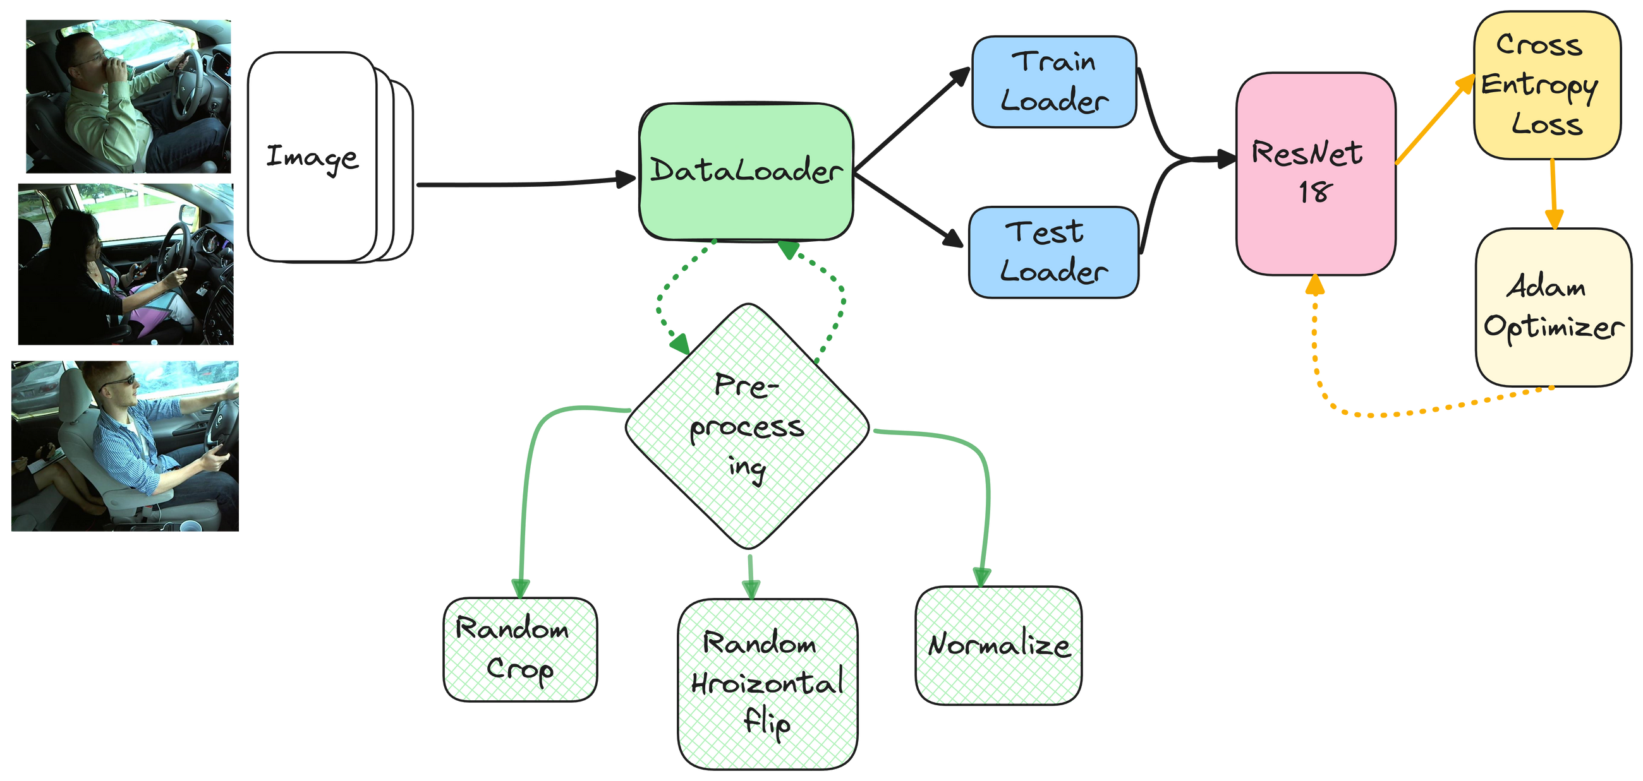
METHODOLOGY

Slide 7
RESULT
Resnet 18
VGG-16
92%
40%
Training
Validation
49%
10%

Slide 8

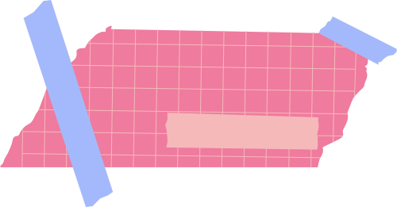
Future
1
Real-time Detection Systems:
work
2
Personalization and User Feedback:
3
Education and Awareness Campaigns:

Slide 9



REFRENCES
https://www.kaggle.com/competitions/state-farm-distracted-driver-detection/code
https://www.sciencedirect.com/science/article/pii/S2667305322000163
https://arxiv.org/pdf/2204.03371
https://www.mdpi.com/1424-8220/23/8/3835
https://pytorch.org/vision/main/models/generated/torchvision.models.resnet18.html

Slide 10
THANK
YOU!

